Slide 1
Utilizing CRISPR/Cas9 to Artificially Induce
Aging in 3-D hiPSC-based Models of Neurodegenerative Disease
Lexi Bounds
School of Biological and Health Systems Engineering
Arizona State University

Slide 2
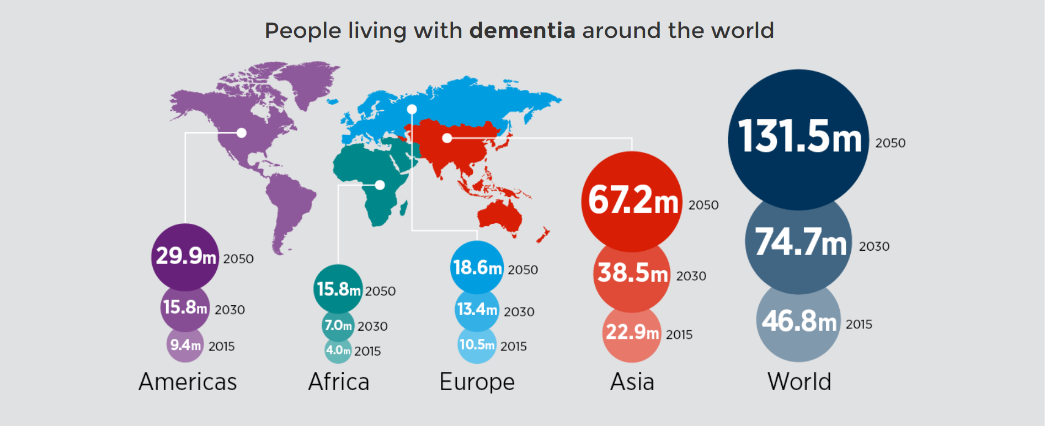
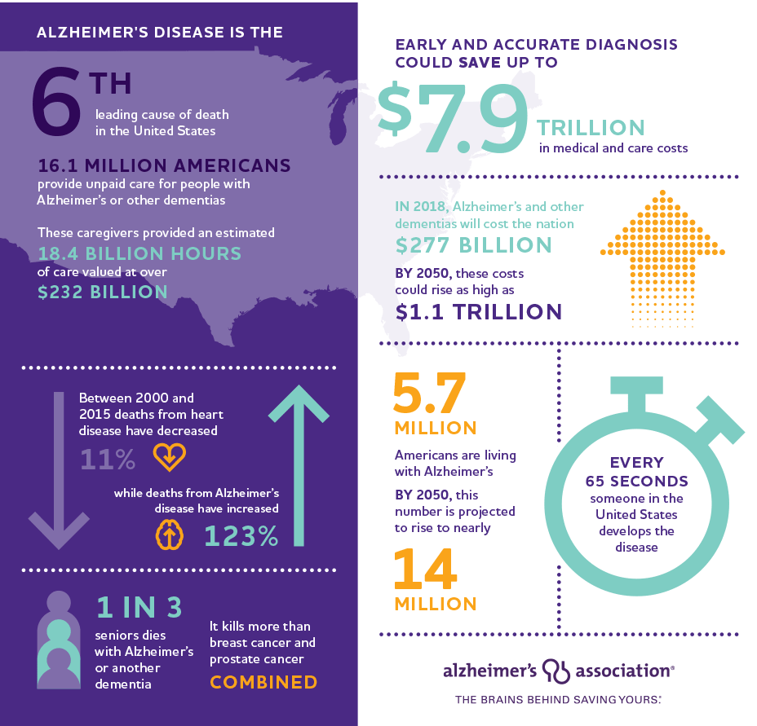
Alzheimer’s Disease is a Deadly Neurodegenerative Disease
Alzheimer's & Dementia (2017)

Slide 3
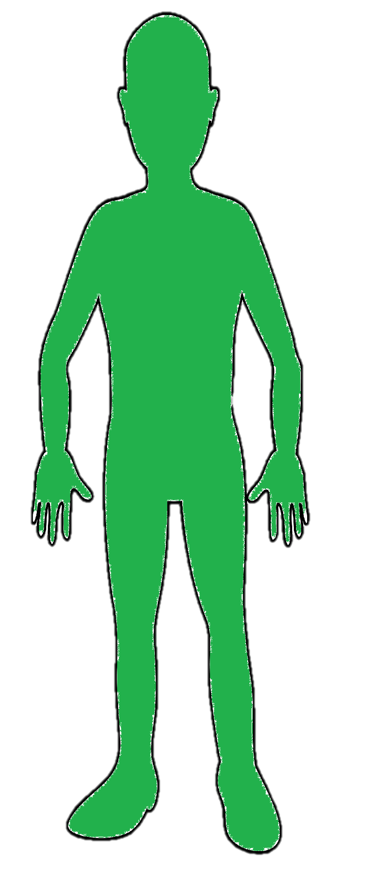
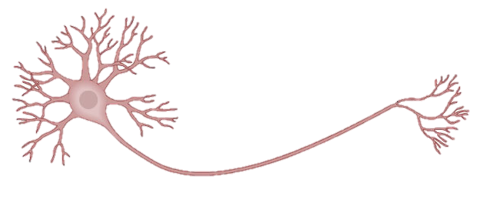


hiPSC-Based Models of Alzheimer’s Disease
KMOS Factors
Differentiate
Healthy Control
Drug Discovery
KMOS Factors
Cell Therapy
Differentiate
FAD Patient
Disease Modeling
KMOS Factors
Differentiate
SAD Patient

Slide 4

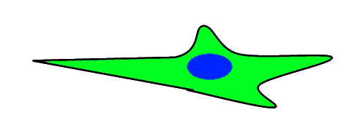

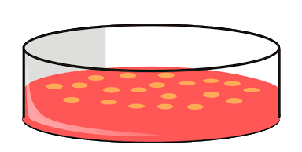
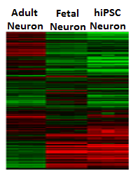

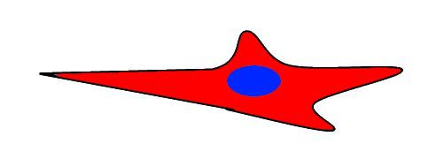
Current Limitations of hiPSC-Based Models of Neurodegenerative Diseases
Oct4
Sox2
Young donor
Klf4
C-Myc
Young neurons
Oct4
Sox2
Old donor
Klf4
C-Myc
Young neurons
Neuronal aging marks are absent in hiPSC-derived neurons
Inability to observe phenotypes associated with late-onset of the disease in aging adults

Slide 5
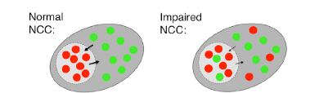
Role of RANBP17 in Aging
RANBP17 = RAN Binding Protein 17
Age
NES = nuclear export signal
NLS = nuclear localization signal
Function
Function: Maintains proper nucleocytoplasmic compartmentalization (NCC)

Slide 6

Hypothesis: By repressing this gene, can we induce an aged phenotype into hiPSC-based disease models?
Oct4
Sox2
Young donor
Klf4
C-Myc
Young neurons
Oct4
Sox2
Old donor
Young neurons
Klf4
C-Myc
Old neurons
dCas9-KRAB + gRNA

Slide 7
Clustered Regularly Interspaced Short Palindromic Repeat (CRISPR)/Cas9
TSS = Transcription Start Site
GOI
Cas9
dCas9
GOI
GOI
KRAB
GOI
GOI
RNAP
Double stranded break repaired by HDR or NHEJ
Permanent alterations
Transcription block
Reversible alterations
RNAP
Notes:
DSB repaired by endogenous DNA repair machinery

Slide 8
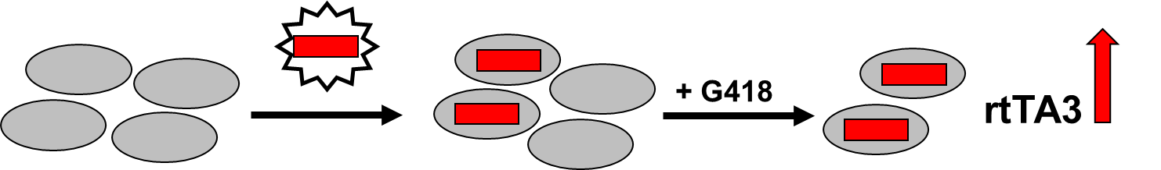
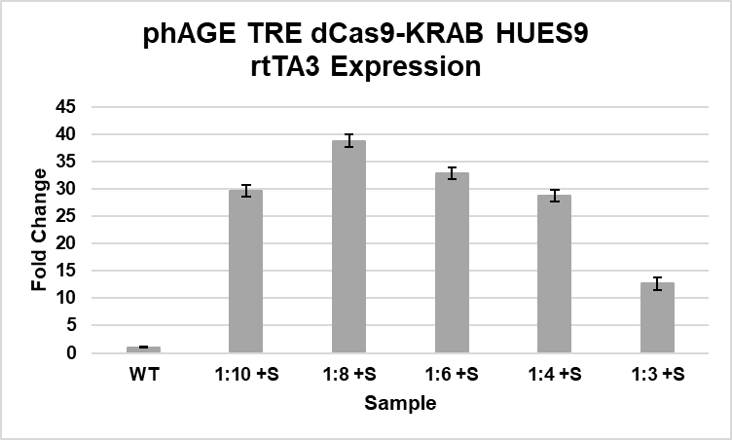
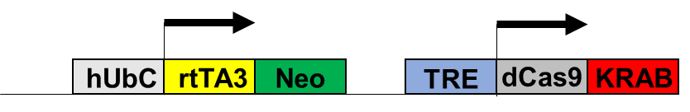
Perform G418 kill curve
Transfect 293T cells
Filter, concentrate virus
Transduce HUES9s
Expansion under G418 selection
Perform doxycycline induction
Selection and Expansion of phAGE TRE dCas9-KRAB HUES9
1:8 +S (HOURS AFTER PASSAGE)
24 HRS
48 HRS
1000 um
1000 um
72 HRS
96 HRS
1000 um
Fold change normalized to WT HUES9. Samples collected after two weeks of antibiotic selection.
1000 um

Slide 9
Inducible Gene Expression: Tet-On System
+ G418
- DOX
+ DOX
dCas9
dCas9
+ DOX
rtTA3

Slide 10
DOX-Induced dCas9-KRAB Expression
-DOX
1 ug/mL
2 ug/mL
5 ug/mL
HA
400 um
400 um
400 um
400 um
HA/HOECHST
400 um
400 um
400 um
400 um

Slide 11
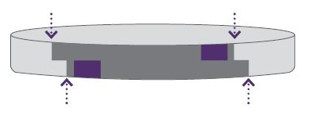
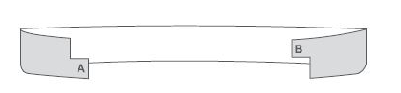
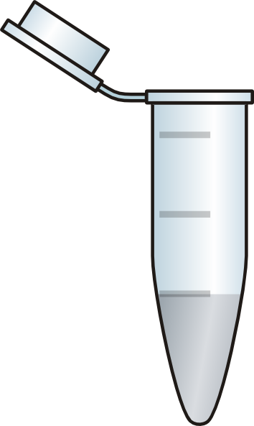

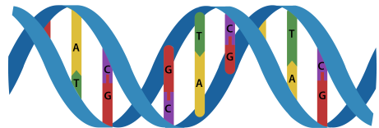
Restriction Enzyme Cloning
BfuAI recognition site
1. Digest sgRNA and vector
sgRNA
Cleavage
2. Gel purify linearized vector
A
sgRNA
B
3. Ligate and transform into bacteria
sgRNA
4. Isolate plasmid and sequence DNA

Slide 12
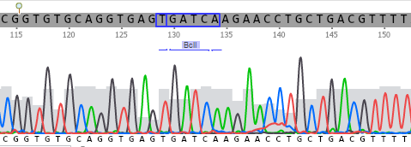
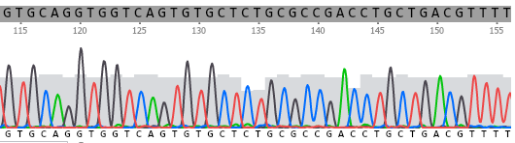
DNA Sequencing Confirms gRNA Insertion
pLKO.1-puro U6 sgRNA BfuAI Stuffer
RANBP17 gRNA #1
CGGTGTGCAGGTGAGTGATCAAGAACCTGCTGACGTTTT
GTGCAGGTGGTCAGTGTGCTCTGCGCCGACCTGCTGACGTTTT

Slide 13
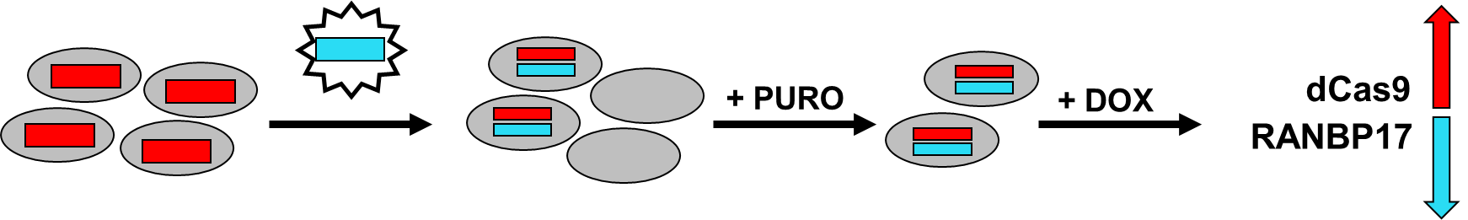
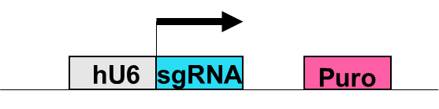
Future Work

Slide 14
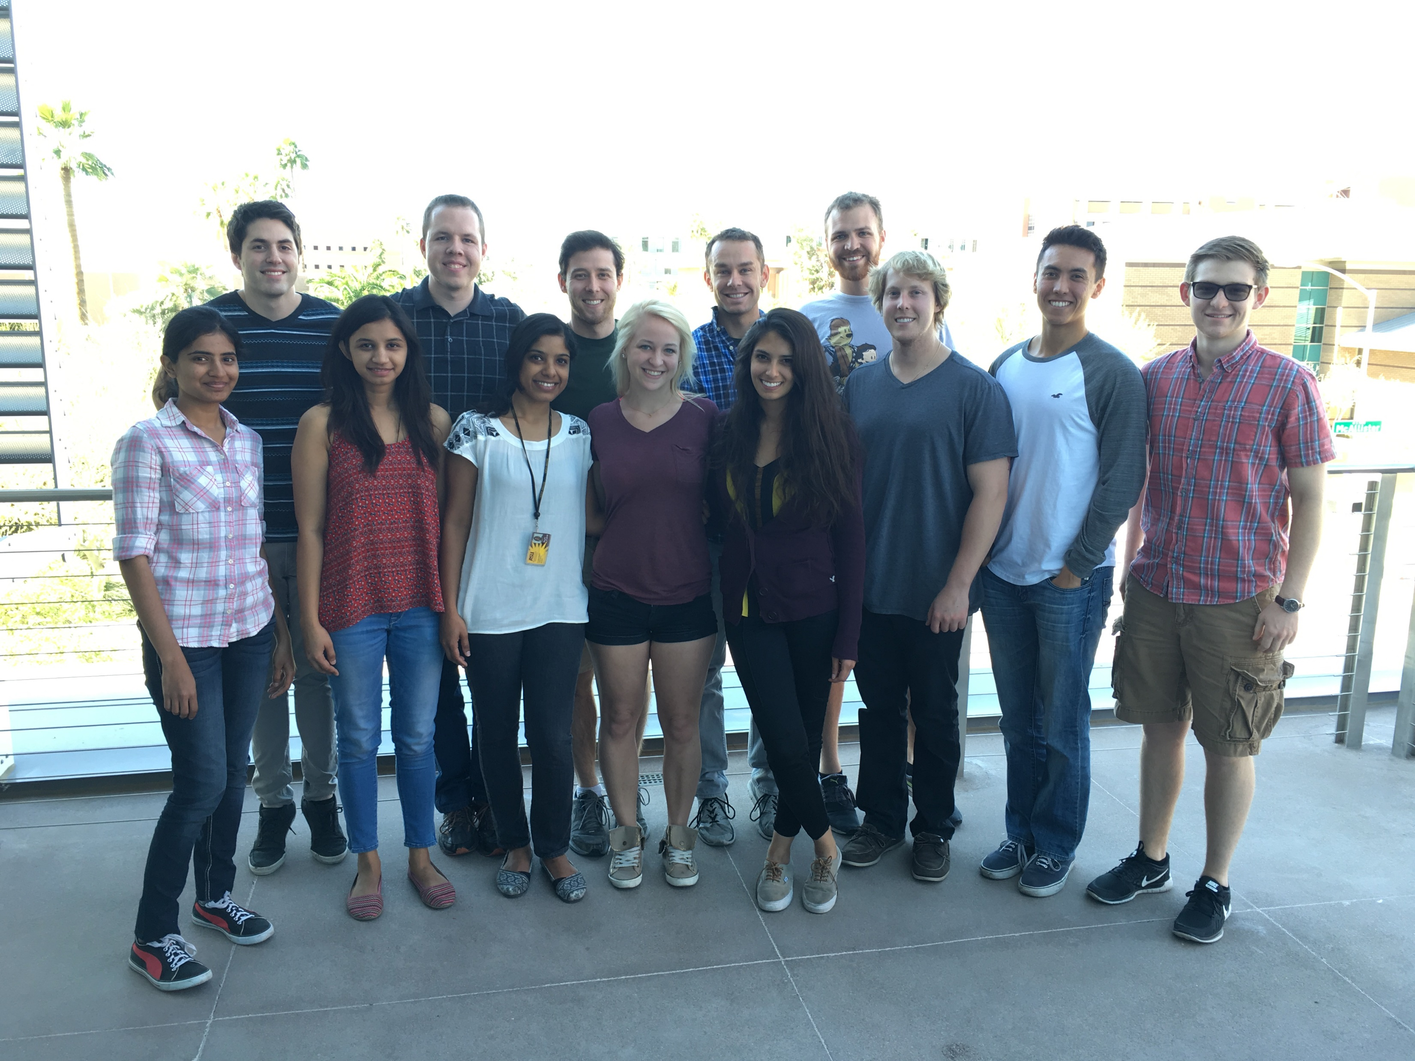




Acknowledgements
ASU/NASA Space Grant
Mentor
David Brafman, PhD
Brafman Lab Members
Nicholas Brookhouser
Sreedevi Raman
Josh Cutts
Gayathri Srinivasan
Daylin Morgan
Jake Packer
Sebastian Fonseca
Carlye Frisch
Esther Sim
Jacob Knittel
Tanner Henson
Warner Kostes
Graduate Mentors
Rachel Lundeen
Francis Petty
Stabenfeldt Lab
Dr. Sarah Stabenfeldt
Vimala Bharadwaj
Crystal Willingham

